Slide 1

Case Study Cooperative and Autonomous Systems – WS25/26
Prof. Dr. Igor Doric
Presented by:
Nitin Medisetti, nitin.medisetti@stud.th-deg.de
Saikumar Konankanchi, saikumar.konakanchi@stud.th-deg.de

Slide 2
AGENDA
Recap Sensor Kit, Wiring Plan
Sensor Datasheets
Arduino IDE
Integration of ESP Dev & ESP Cam
Code Explanation
Working Live Demo
Conclusion

Slide 3
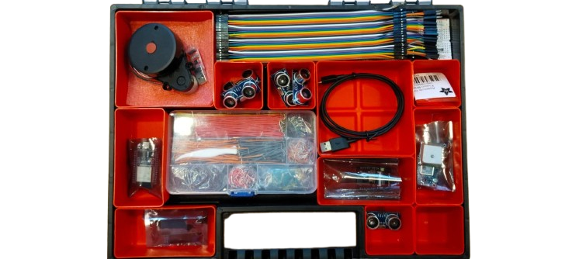
SENSORS

Slide 4
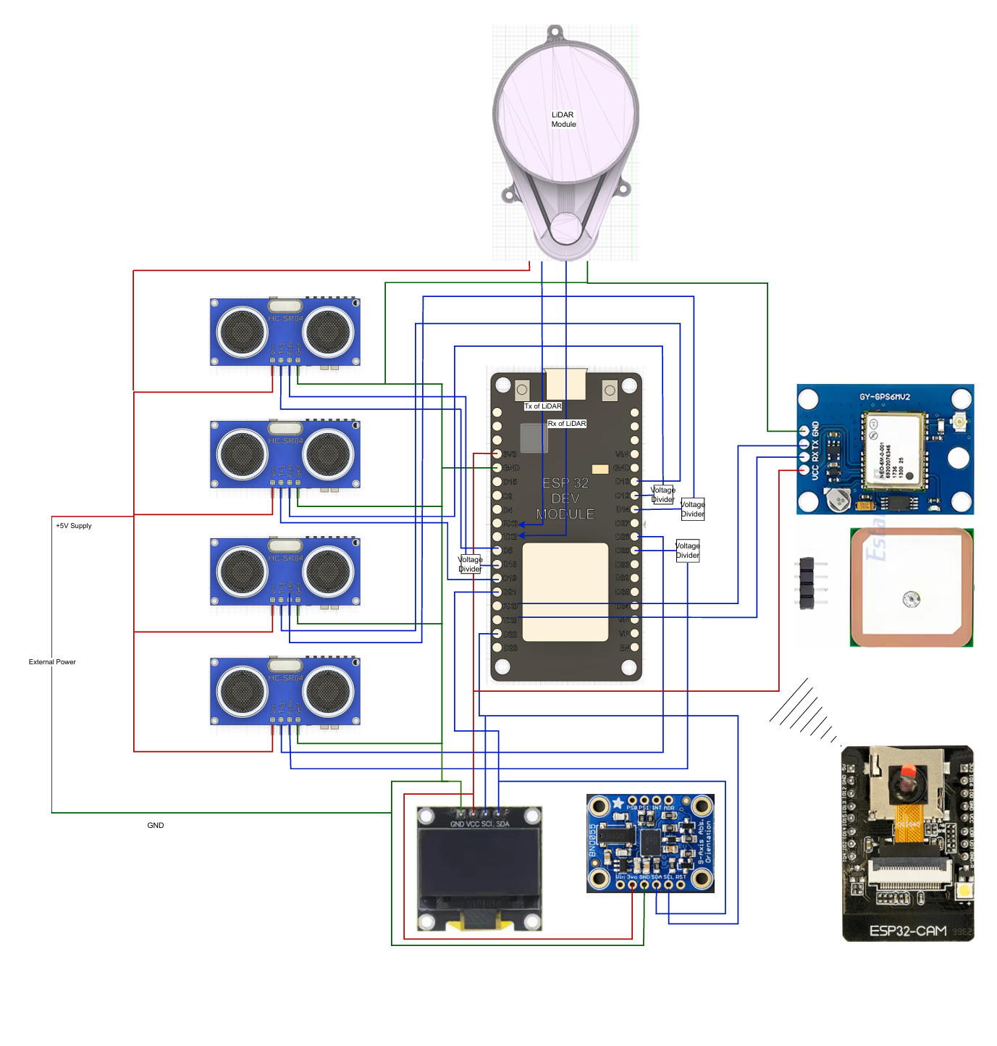
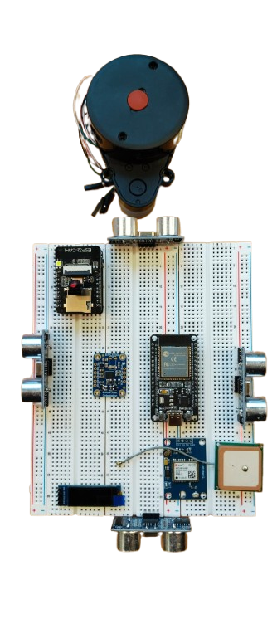

Slide 5
SENSOR DATASHEETS
Uploaded on ilearn in Technical Specifications Section

Slide 6

ARDUINO IDE
Simplicity and Accessibility
Wide range of compatible boards and libraries
Integrated Development Environment
Text Editor
Compiler
Serial Monitor
Latest Version is 2.3.6
Download Link: https://www.arduino.cc/en/software/
https://www.google.com/url?sa=i&url=https%3A%2F%2Fwww.hackster.io%2Farduino%2Fproducts%2Farduino-ide%3Fref%3Dproject-0973c0&psig=AOvVaw37swY_5uu5YeDr1WtitM-8&ust=1760142270776000&source=images&cd=vfe&opi=89978449&ved=0CBUQjRxqFwoTCMig9L6vmJADFQAAAAAdAAAAABAE

Slide 7
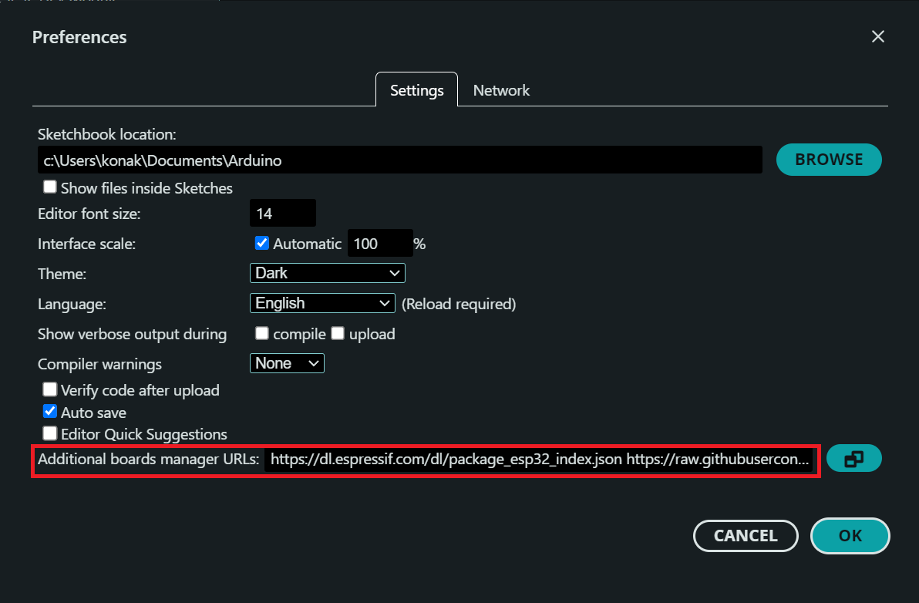
Integration of ESP Dev and CAM Modules
Setting Up the IDE
Open Arduino IDE → File → Preferences
In Additional Board Manager URLs, we must add this link for proper reading of ESP 32 boards by the IDE
https://dl.espressif.com/dl/package_esp32_index.json

Slide 8
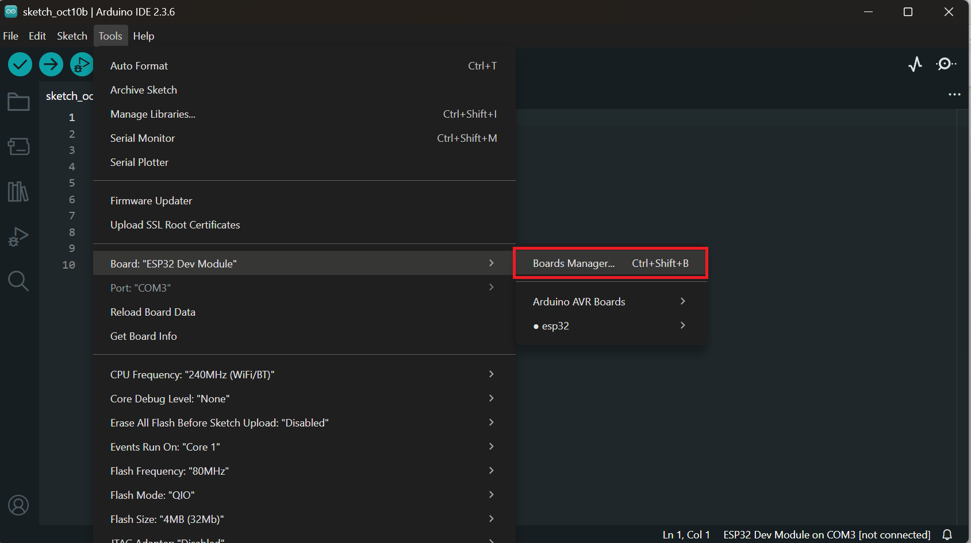
Setting Up of IDE Cont...
Go to Tools → Board → Boards Manager
Search for ESP32 and click Install
This adds all ESP32 variants:
ESP32 Dev Module
ESP32-CAM (AI Thinker)
ESP32-S2/S3 etc.

Slide 9
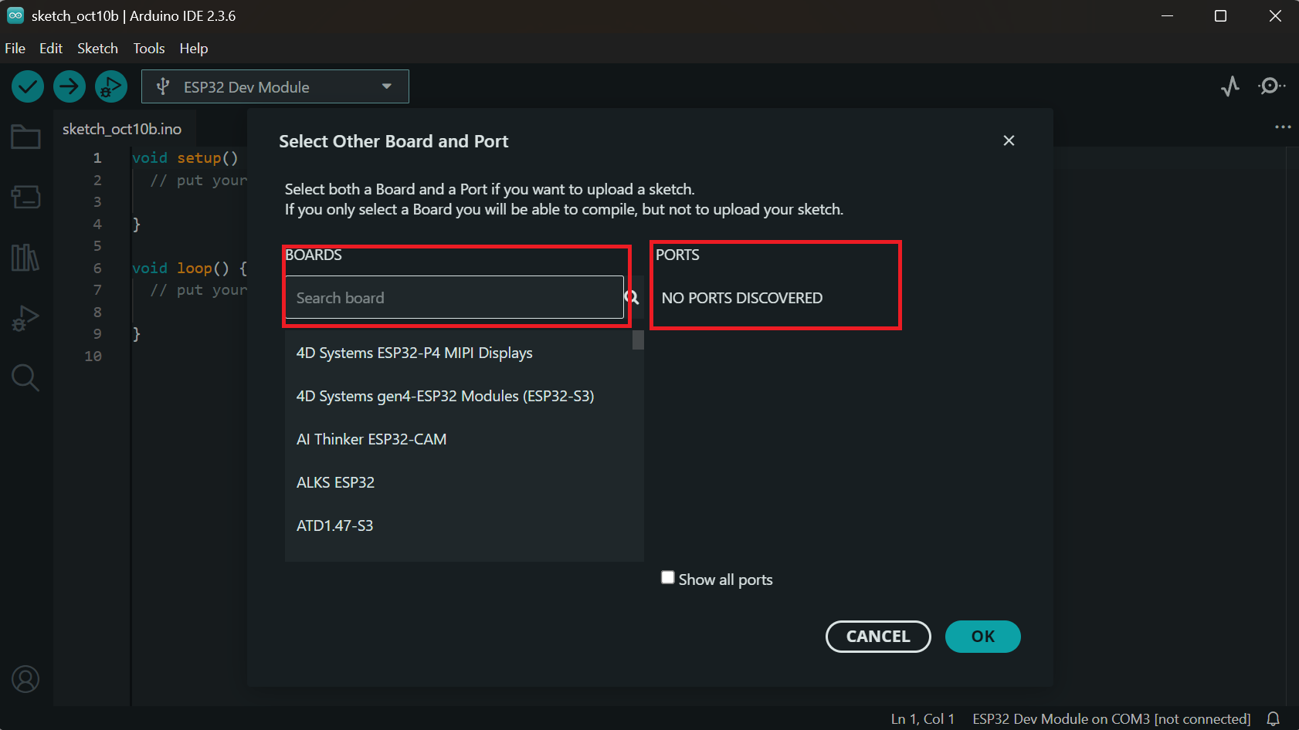
Setting Up of IDE Cont...
Selecting the Correct board
Tools → Board → ESP32 Dev Module
Tools → Board → AI Thinker ESP32-CAM
Tools → Port(respective ports for each module to which they are connected)

Slide 10
Libraries Required
WiFi.h Enables Wi-Fi and STA(Station) mode connection
esp_now.h Protocol which we are going to follow
esp_camera.h For Capturing Image from CAM module
WebServer.h For webpage and the basic buttons
Arduino.h For Basic Arduino Functions
All of these libraries are included in the ESP32 package
Using a variety of sensors, processing all the data gathered, via a centralized microcontroller.
Path-finding algorithm to navigate around the pre-determined environment.
Autonomous navigation to a desired destination avoiding obstacles.

Slide 11
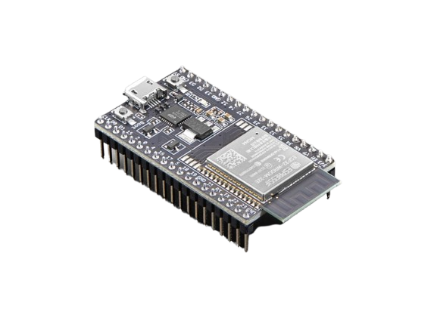
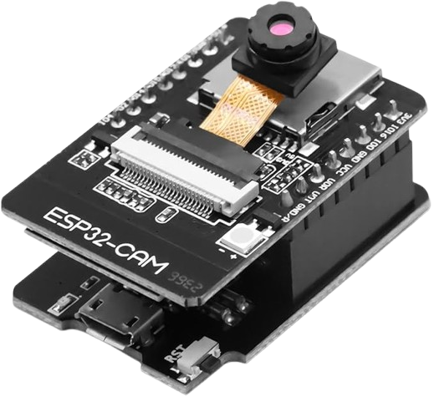

Understanding the Idea
ESP DEV Module: Receiving commands from CAM module and executing them
ESP CAM Module: Hosting the Web Page with buttons and Streaming the Video

Slide 12
Communication Protocol
ESP-NOW: Developed by Espressif Systems
Uses MAC address for Peer-to-Peer communication
Transmits in Microseconds
Faster than HTTP or MQTT
Works in Wi-Fi STA(Station) mode so both devices stay on the same channel
This lets the communication be even quicker
https://docs.espressif.com/projects/esp-idf/en/stable/esp32/api-reference/network/esp_now.html

Slide 13
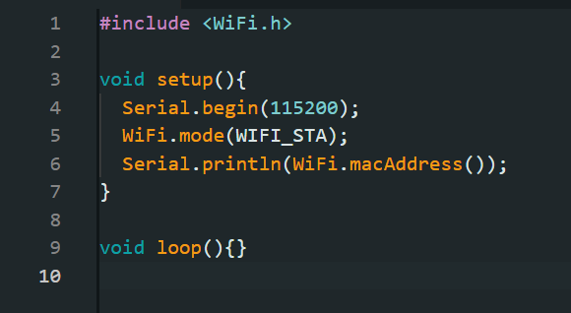
Accessing the MAC address of Dev Module:
This Snippet will return the MAC address of the board
The Address will be unique for every board and is of 12-digit Hexadecimal number
Example: 00:1A:2B:3C:4D:5E

Slide 14

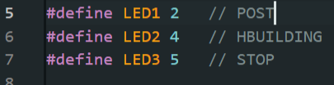
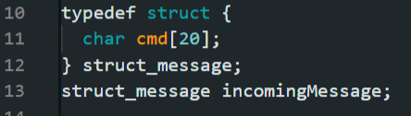
Receiver Code:
Libraries Required
WiFi.h Library to enable the board connect to the WiFi Networks and configure different Modes
STA-Station Mode
AP-Access Point
Defining GPIOs, to make different LEDs blink for different commands
Both the Sender and Receiver should be on same data structure for proper communication
This structure stores a 20-character array (cmd), which holds text like:
"POST", "HBUILDING", or "STOP"
When the receiver gets a package, it will be copied to incoming message.

Slide 15
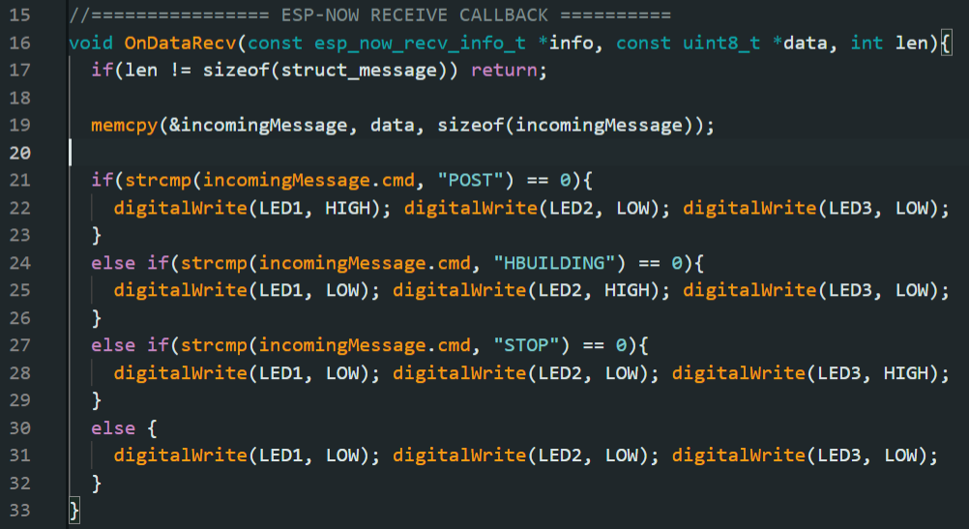
Cont..
Callback Function:
Registered via esp_now_register_recv_cb(), this function is automatically triggered whenever the receiver gets a new ESP-NOW packet
If the received data length matches our structure
Then uses memcpy() to safely copy the incoming data into the incomingMessage variable
strcmp() compares the received text string (cmd) with the known commands.
Depending on the command:
  Turns one LED ON and all others OFF instantly.

Slide 16
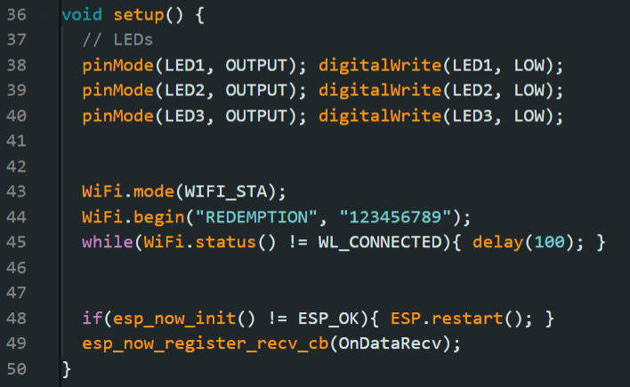
Cont..
GPIO Pin Setup:
Different Pins for different commands
Setting WiFi to Station Mode
Connecting to WiFi
Initializing the ESP_NOW

Slide 17
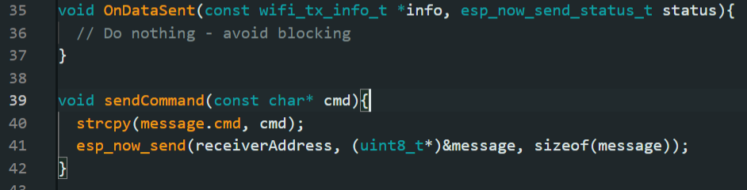
Sender Code:
The Initial Setup is also same for the Sender Module
Defining the Libraries and the Data structure
Copies the selected command into message
Sends it via ESP_NOW

Slide 18
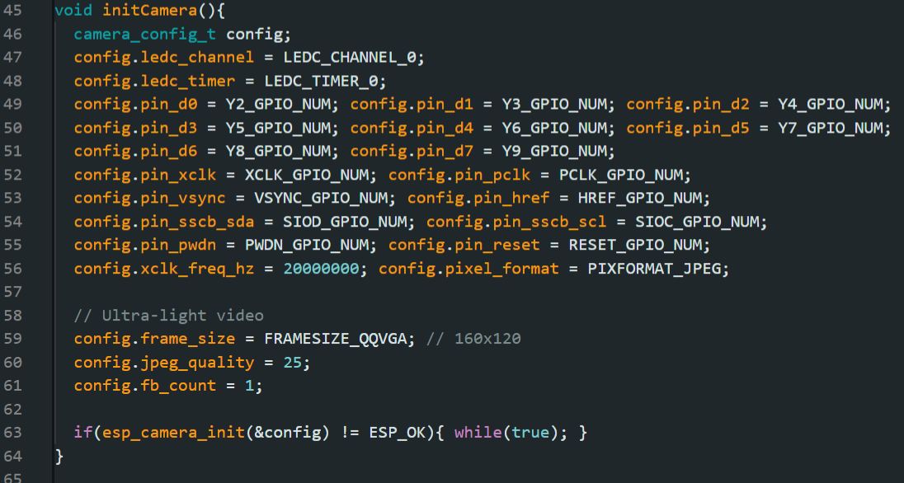
Cont...
Camera Initialization with all the pin connections
Using very low resolution for lag free streaming

Slide 19
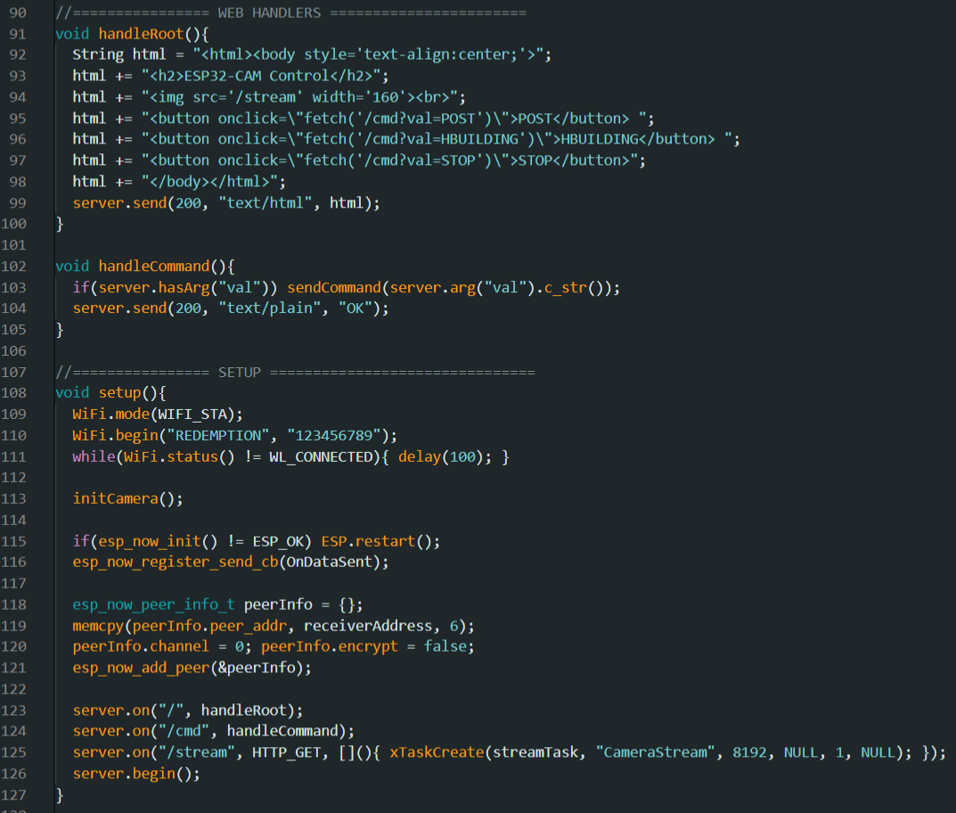
Cont...
Web Handlers handling the UI and button setup
Setup mode: enabling to connect to WiFi and put the board in STA mode
Initializing the ESP_NOW
Connecting to the Peer Receiver via MAC ID
Sending Commands that are pressed in Web Page.

Slide 20
Any Questions?
nitin.medisetti@stud.th-deg.de
saikumar.konakanchi@stud.th-deg.de

